Slide 1
All-sky camera cloud analysis, daytime
Christopher Stubbs
Jan 1 2016.

Slide 2
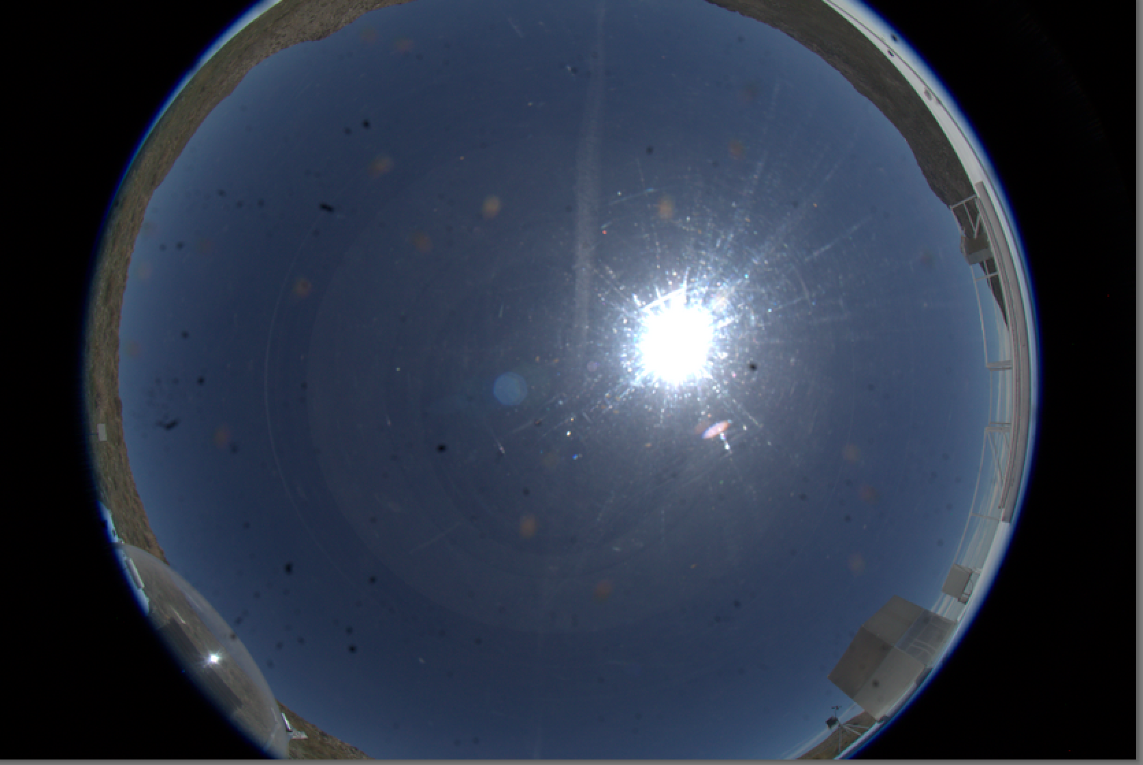
Camera sees horizon to horizon
Canon 5D Mark III
Canon 8-15mm f/4 fisheye lens; r=2f sin(θ/2)
13.5 pixels per degree, 76 arcsec/pixel
LSST field spans 47 pixels

Slide 3
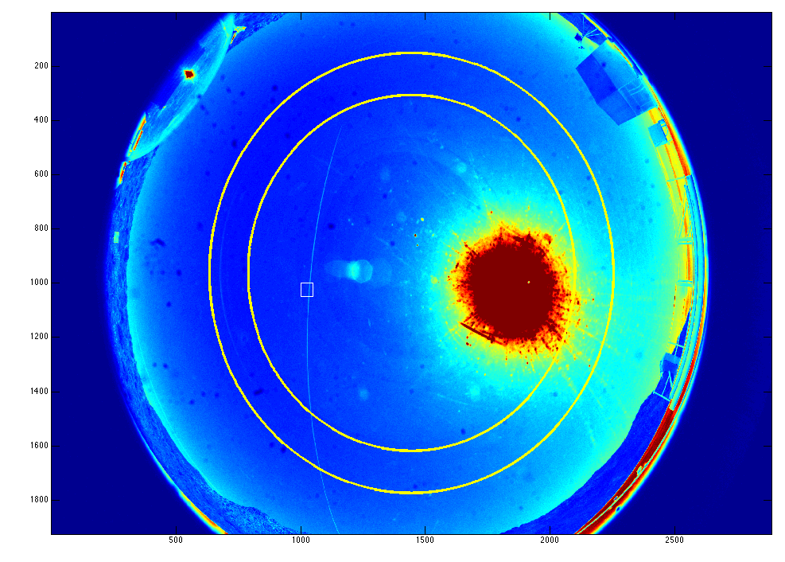
clear day, with contrail
airmass=2.0
airmass=1.5
LSST
field
size
contrail
N
E
ut111415.daycals.0191

Slide 4
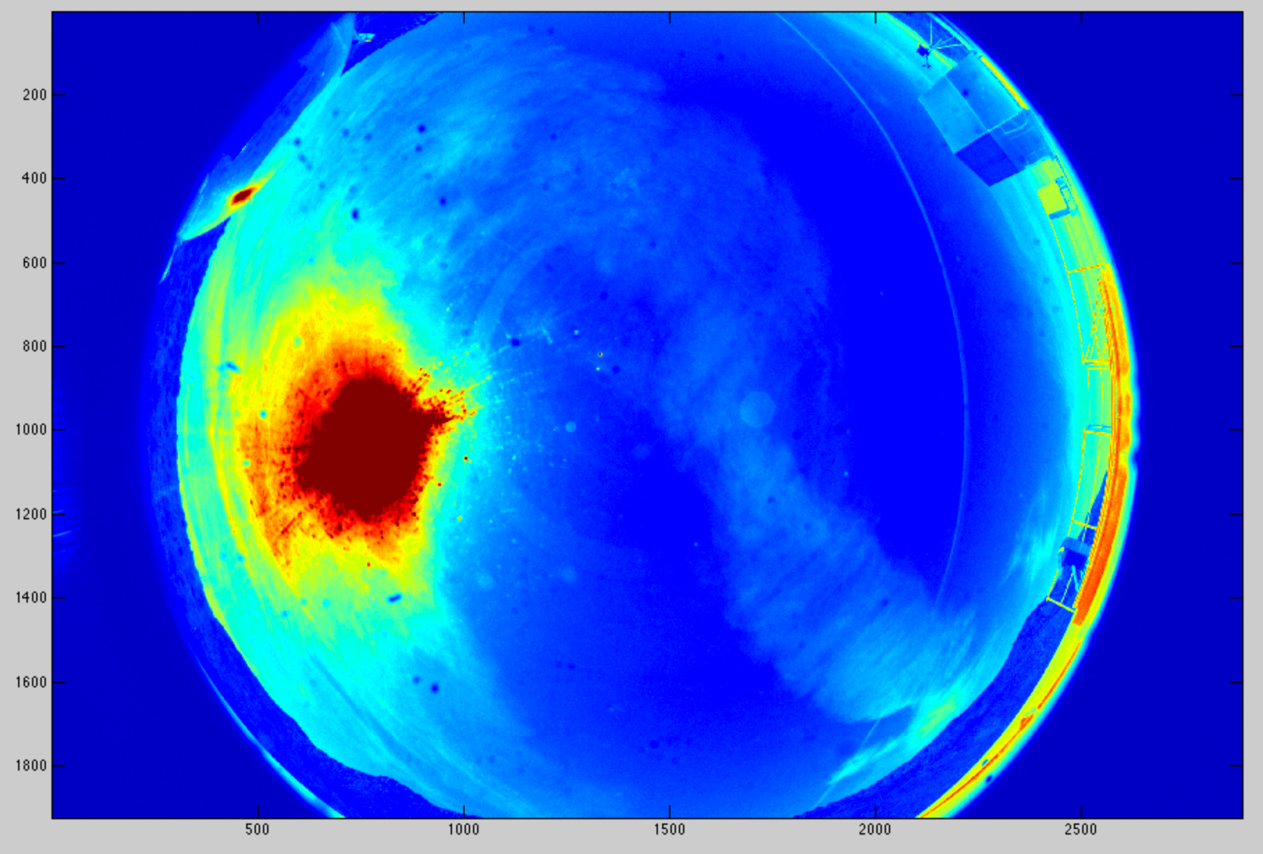
partial clouds, with contrail
contrail
ut111515.daycal.0074.fits

Slide 5
Weather and winds aloft
85442 SCFA Antofagasta Observations at 12Z 15 Nov 2015
-------------------------------------------------------------------------------------------
PRES HGHT TEMP DWPT FRPT RELH RELI MIXR DRCT SKNT THTA THTE THTV
hPa m C C C % % g/kg deg knot K K K
-------------------------------------------------------------------------------------------
1000.0 109
999.0 115 18.0 13.0 13.0 73 73 9.50 320 5 291.2 318.4 292.9
985.0 236 15.6 12.2 12.2 80 80 9.14 299 5 290.0 316.0 291.6
925.0 768 11.0 10.2 10.2 95 95 8.51 205 5 290.6 314.9 292.0
869.0 1287 8.0 7.5 7.5 97 97 7.54 105 5 292.7 314.5 294.0
866.0 1315 8.4 5.3 5.3 81 81 6.49 100 5 293.4 312.3 294.5
859.0 1383 15.0 -6.0 -5.3 23 23 2.86 87 5 300.9 309.9 301.5
857.0 1403 17.4 -8.6 -7.6 16 16 2.34 83 5 303.6 311.2 304.1
850.0 1473 19.4 -17.6 -15.8 7 7 1.14 70 5 306.4 310.3 306.7
849.0 1483 19.8 -18.2 -16.3 6 6 1.08 69 5 307.0 310.7 307.2
842.0 1554 21.2 -27.8 -25.1 2 2 0.47 58 4 309.2 310.9 309.3
804.0 1947 19.1 -26.1 -23.5 3 3 0.57 0 0 311.1 313.1 311.2
…..
http://weather.uwyo.edu/upperair/sounding.html

Slide 6

Blowing screen approximation
sky plane
lens
focal plane
Contrails are curved in focal plane coordinates but straight in sky coordinates
Cloud motions are linear displacements in sky coordinates, curved in focal plane

Slide 7
Mapping focal plane coordinates to tangent plane
X
Z
zenith
angle

Slide 8
Convert from allsky image to binary mask from difference of successive frames.
Three successive images, A,B,C.
Find location of sun in each frame, and out mask a circular region
Construct C-B and B-A difference frames.
This gives spatial gradient of cloud structure, suppresses glints
Subtract median value from each difference image
Suppress edge effects from intensity variations on horizon
Set M(R>Rmax)=0
Do spatial average by smoothing with 10 pixel kernel
Compute standard deviation of each difference image
Find pixels that exceed a threshold that depends on distance from sun
Convert this mask frame onto tangent plane coords, 1K x 1K image
Perform 1) 2-d correlation to detect cloud motion, and/or
2) contrail detection (line detection in sky plane)

Slide 9
Tentative conclusions based on very limited data set
Clouds
Cloud structures are spatially coherent over time scales of 5-10 min
Cloud structures advect across the sky in accord with frozen
screen approximation
This implies we should be able to predict m5 structure ahead of time
Contrails
Contrails are readily detectable as straight lines in sky coords
Contrail propagation also conforms to frozen screen approximation
Optical vs. IR all-sky images
This basic approach is likely to work with IR all-sky images
if we have sufficient SNR

Slide 10
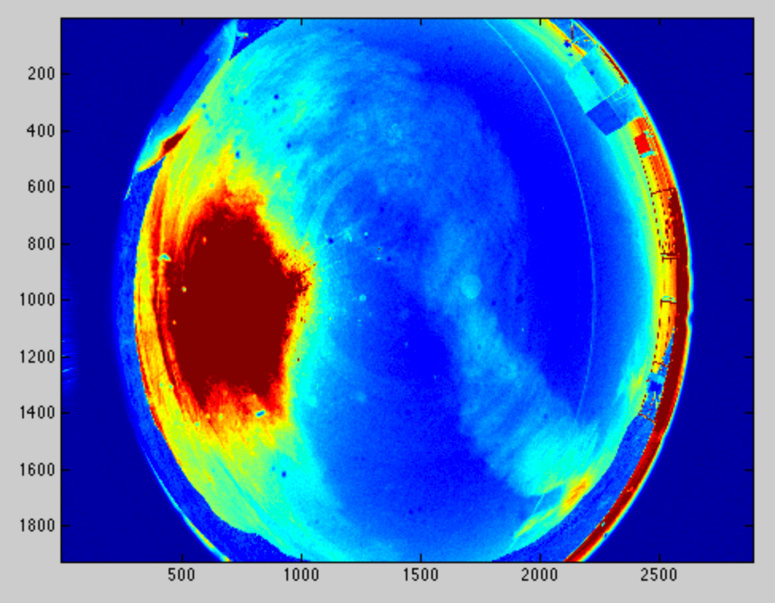
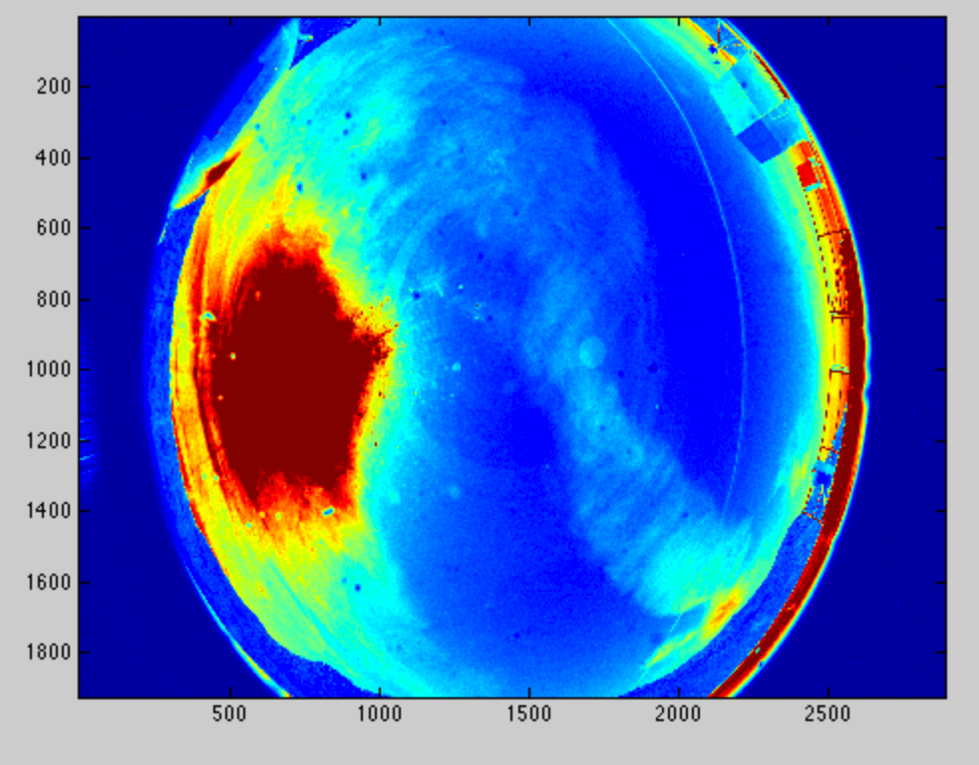
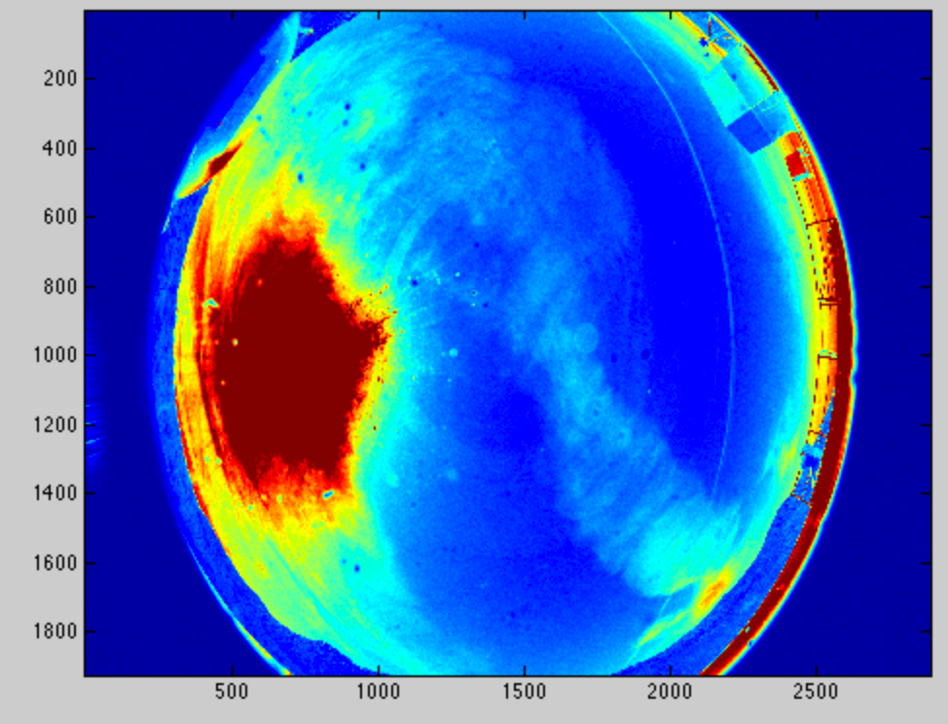
Image processing for cloud-gradient propagation
focal plane coordinates

Slide 11
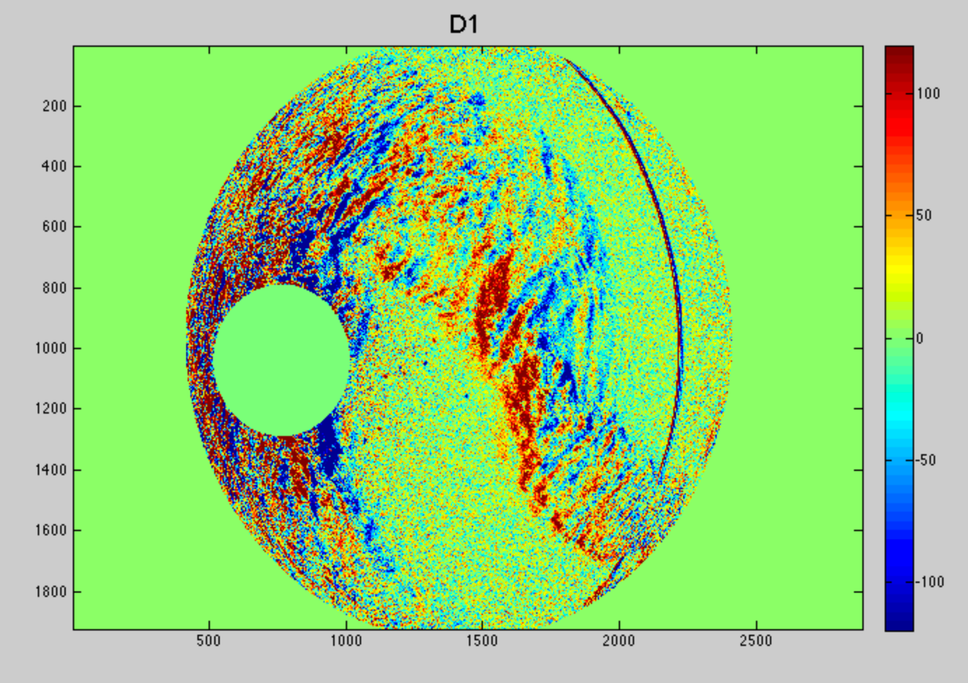
Difference images show cloud gradient propagation
focal plane coordinates

Slide 12
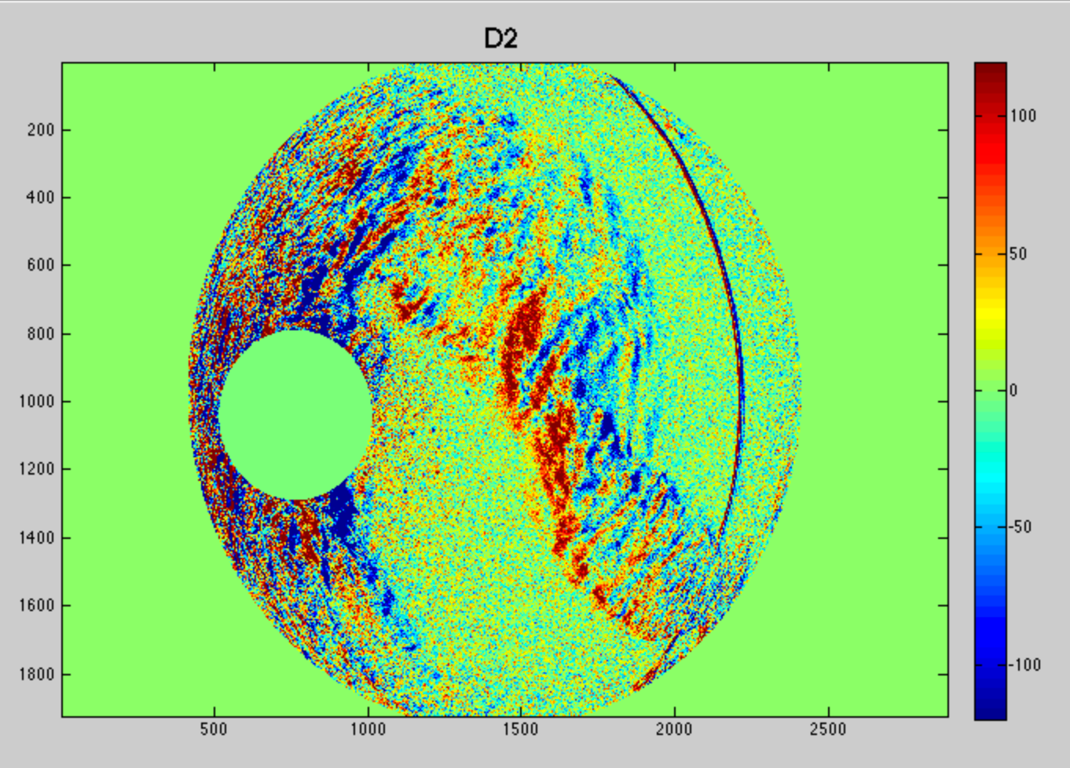
Difference images show cloud gradient propagation
focal plane coordinates

Slide 13
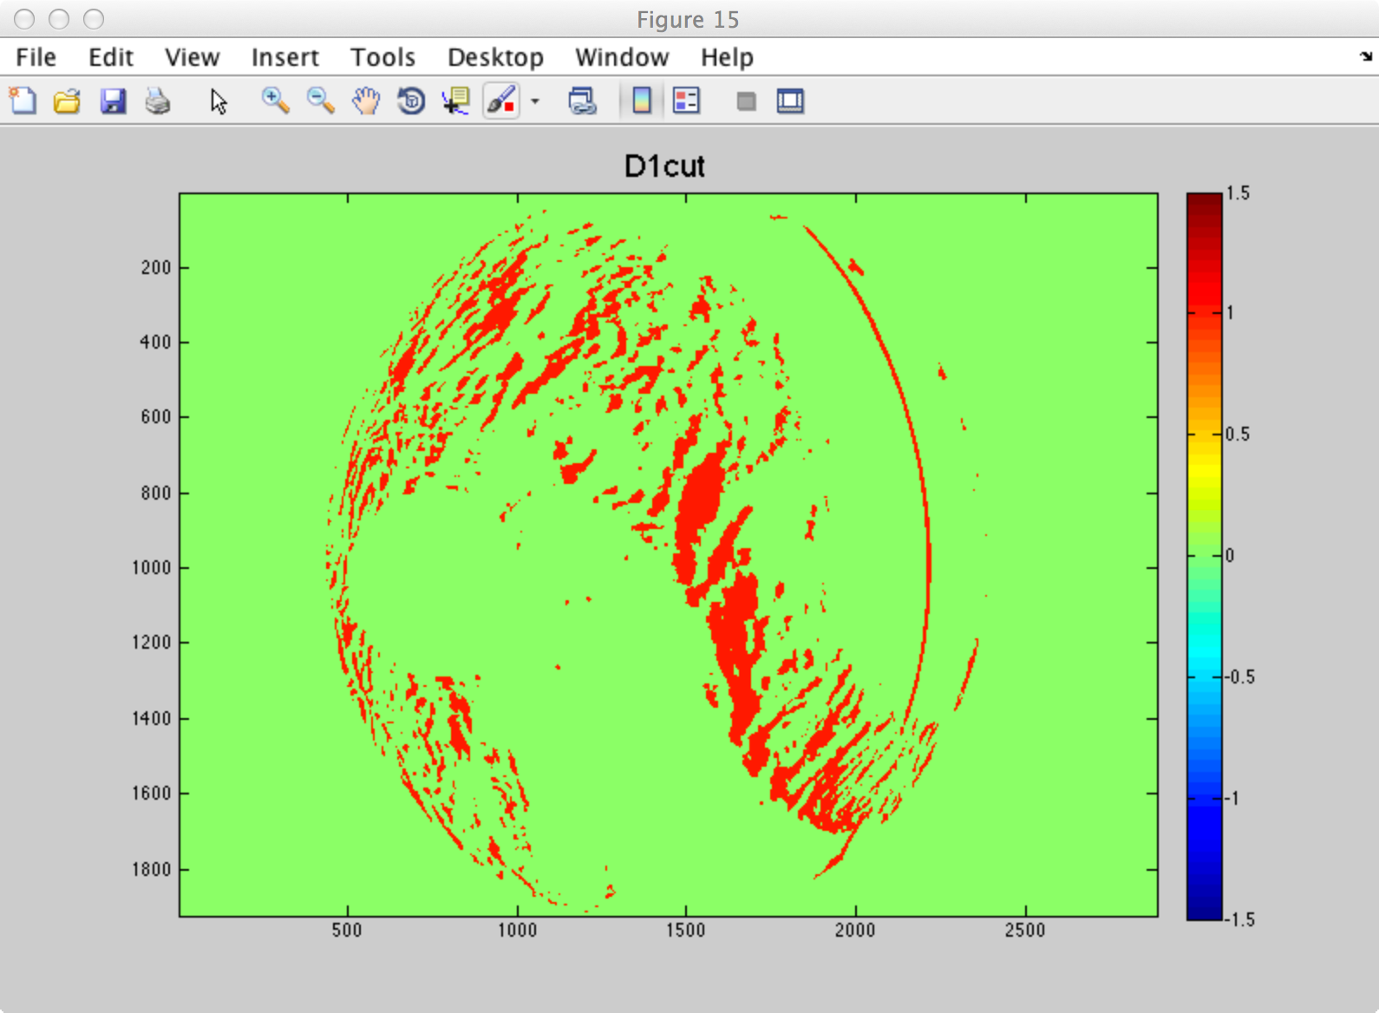

Slide 14
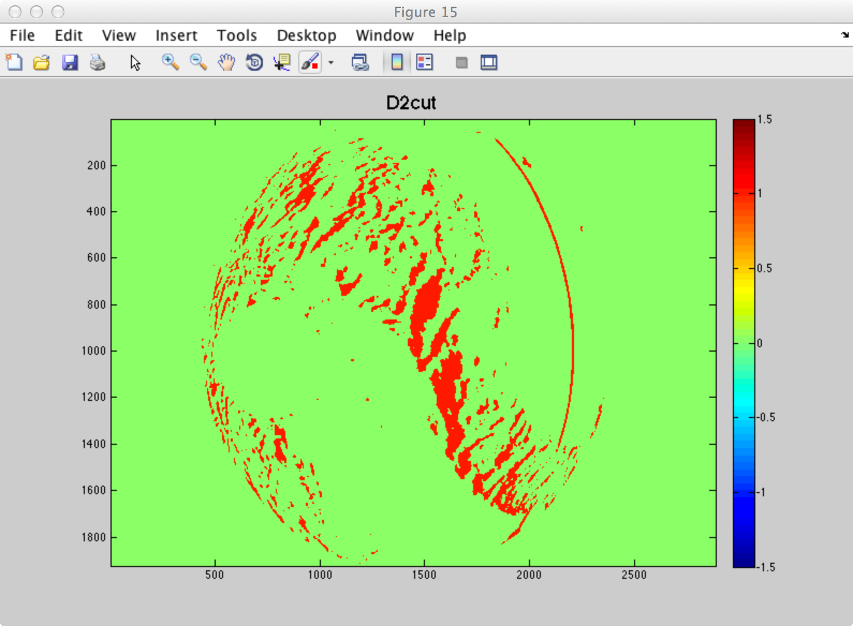
Mapping focal plane coordinates to tangent plane

Slide 15
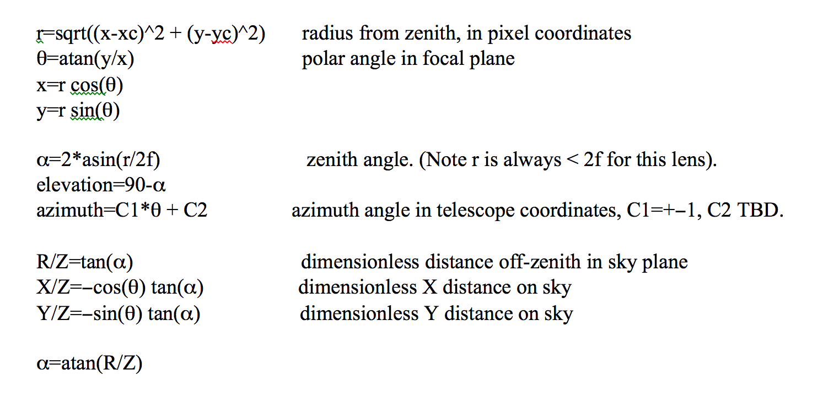
Mapping from focal plane coordinates to sky coordinates
tangent plane coordinates are in capital letters, focal plane coords are lower case

Slide 16
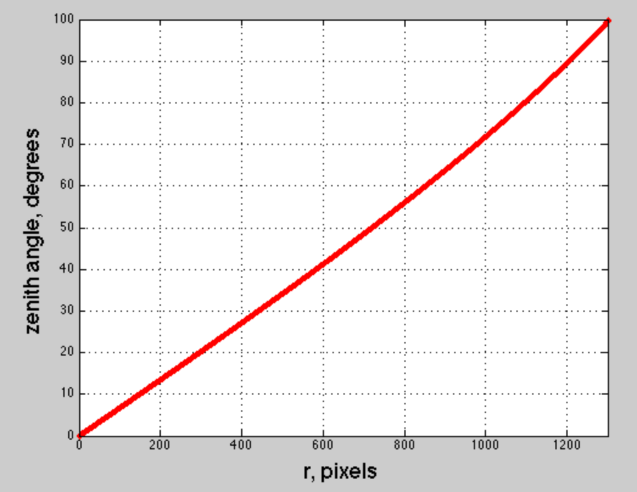
Mapping focal plane coordinates to tangent plane

Slide 17
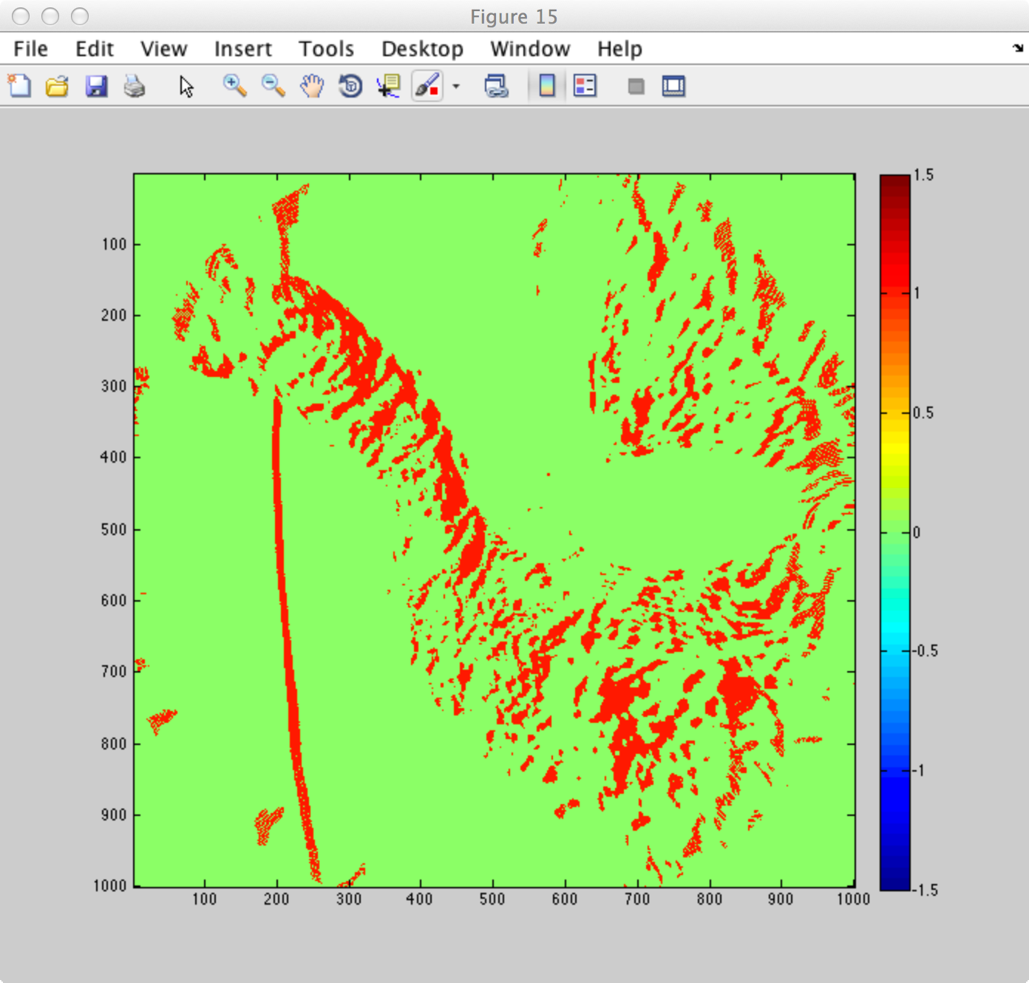
Cloud gradient mask in sky coordinates
D1cutsky

Slide 18
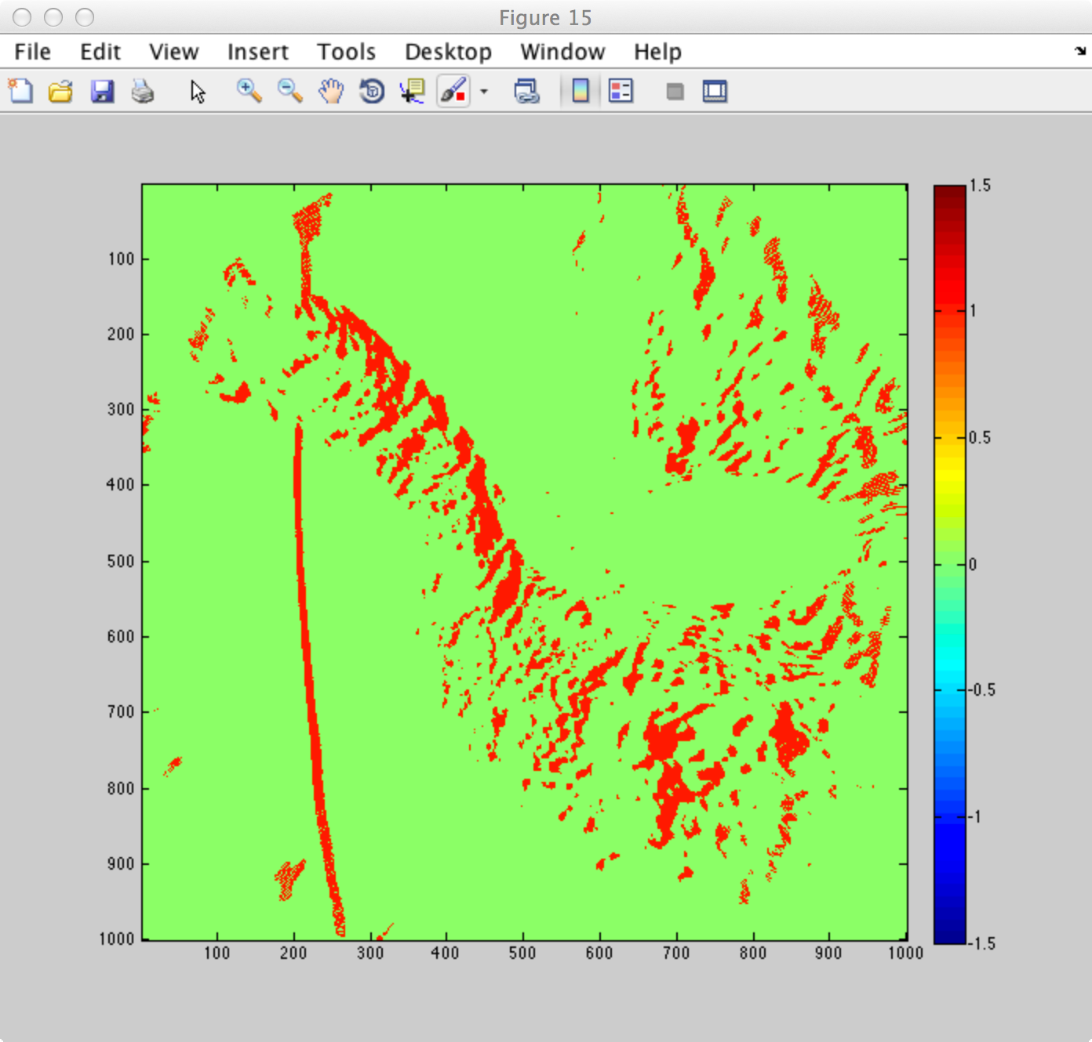
Cloud gradient mask in sky coordinates
D2cutsky

Slide 19
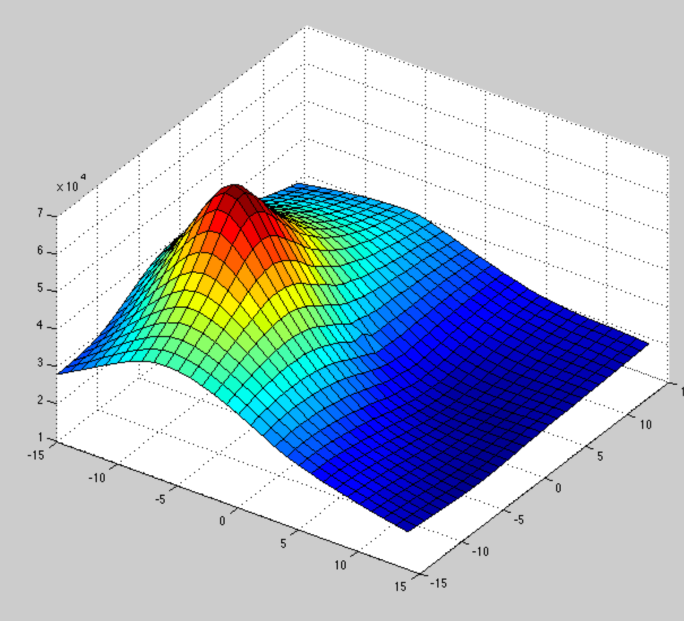
Cross-correlation of sky-coordinate cloud gradient mask frames

Slide 20
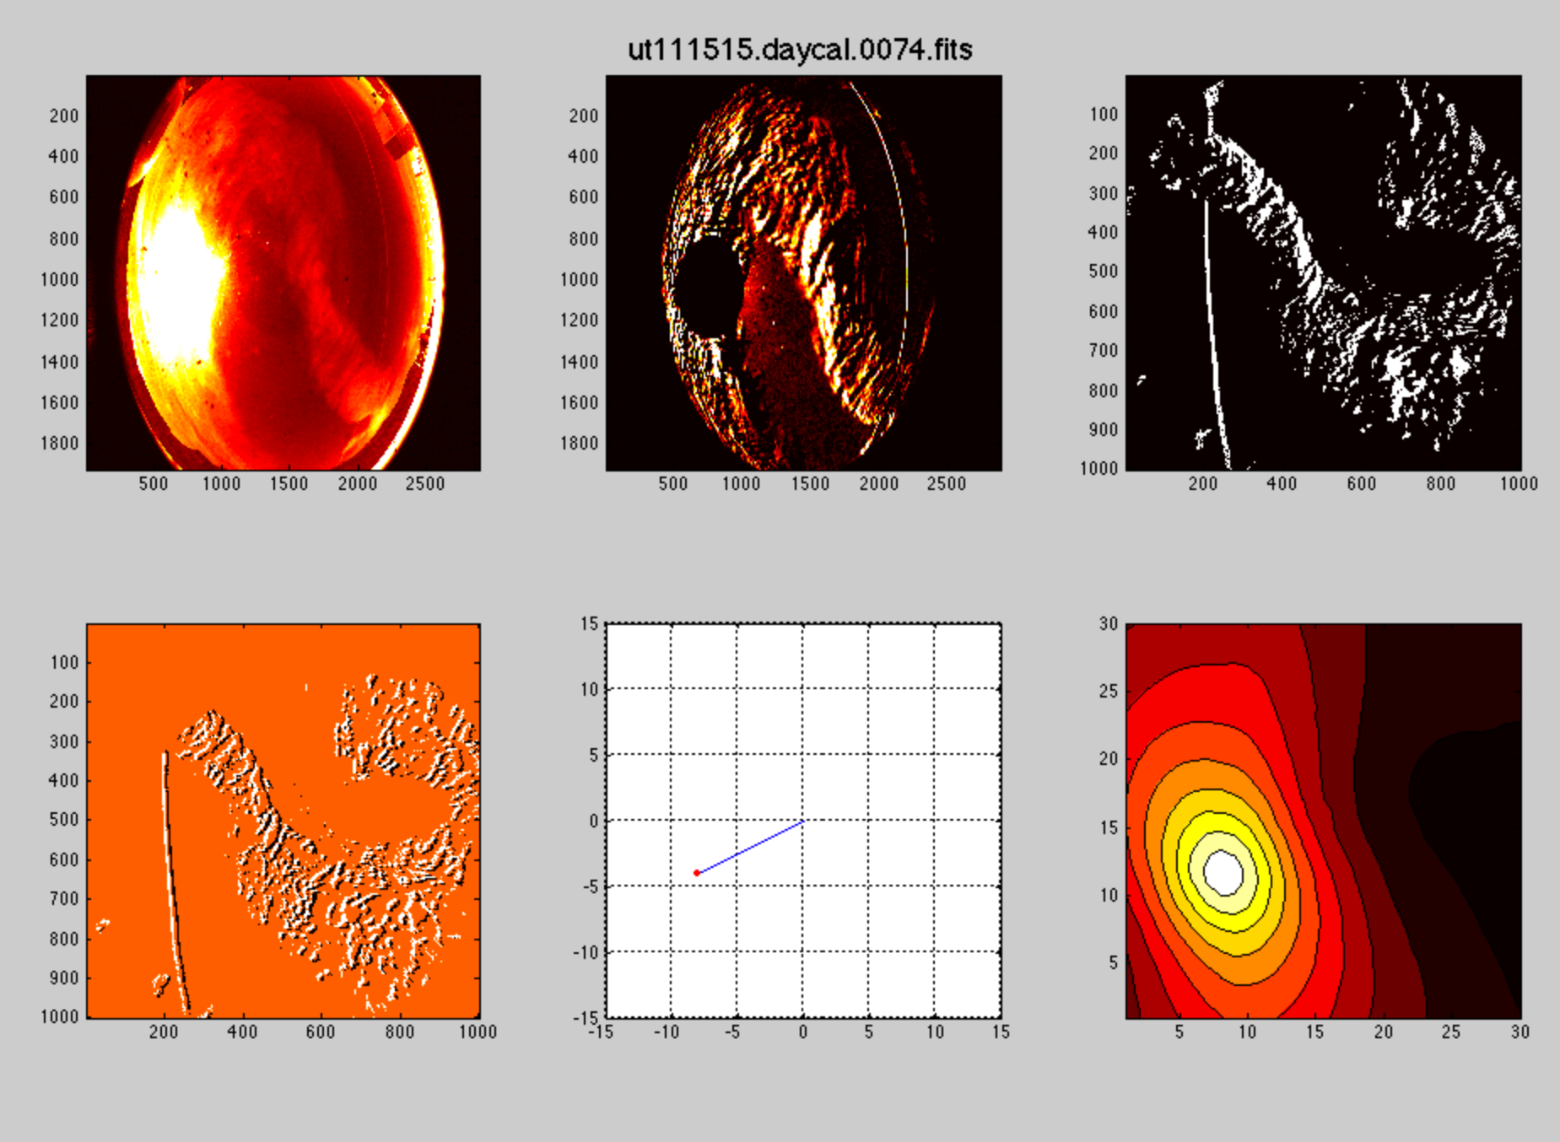
original image, difference image mask image
focal plane coords focal plane coords sky coords
difference images offset vector 2-d cross-correlation
sky coords sky pixel coords

Slide 21
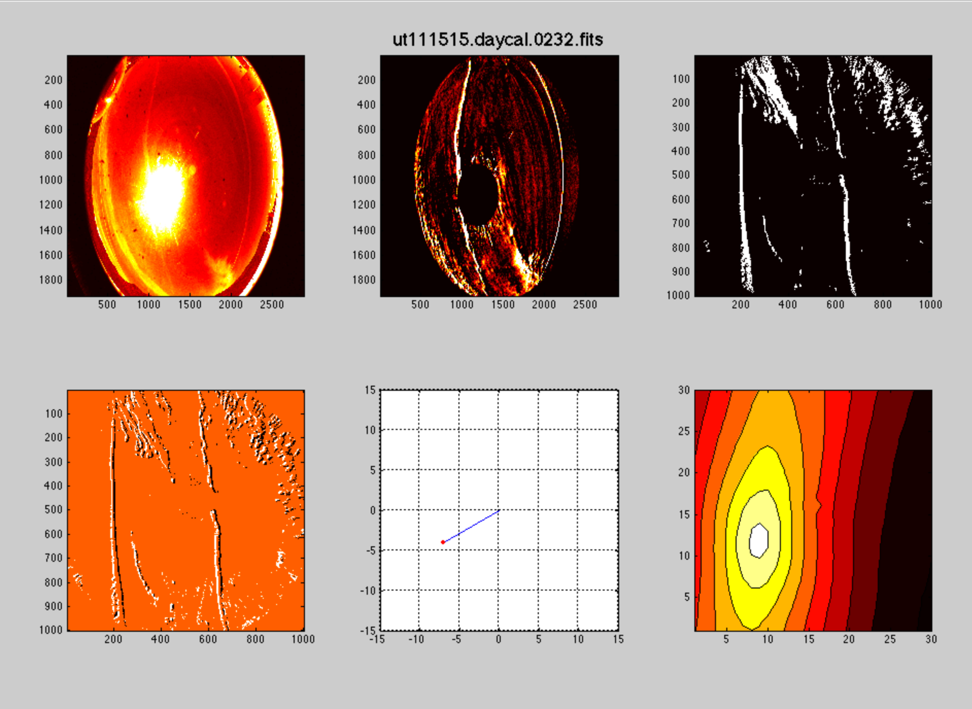
original image, difference image mask image
focal plane coords focal plane coords sky coords
difference images offset vector 2-d cross-correlation
sky coords sky pixel coords

Slide 22
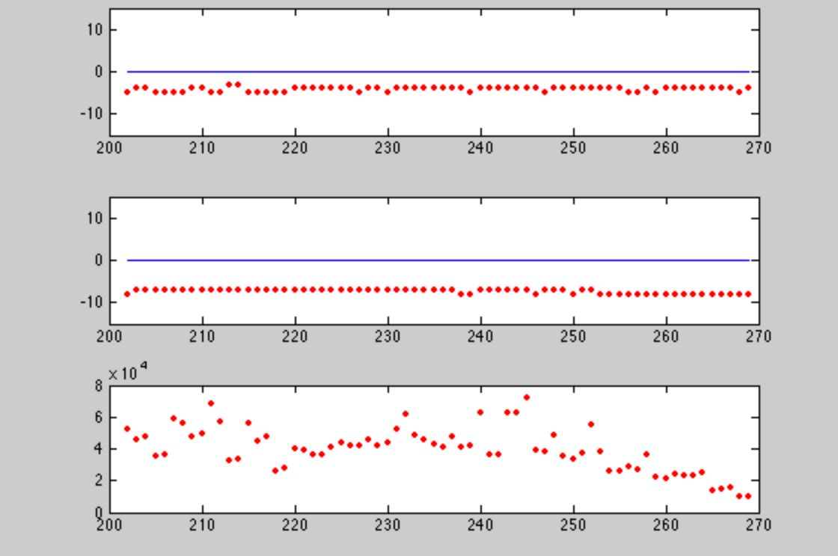
Long-term stability of motion vector
Δy
Δx
cross-correlation peak

Slide 23
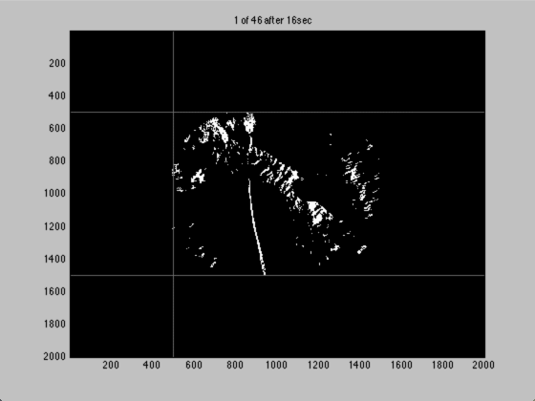
Transfer to co-moving cloud coordinates Cloud pattern essentially stable over 10 minutes

Slide 24
Detection and parametric characterization of contrails

Slide 25
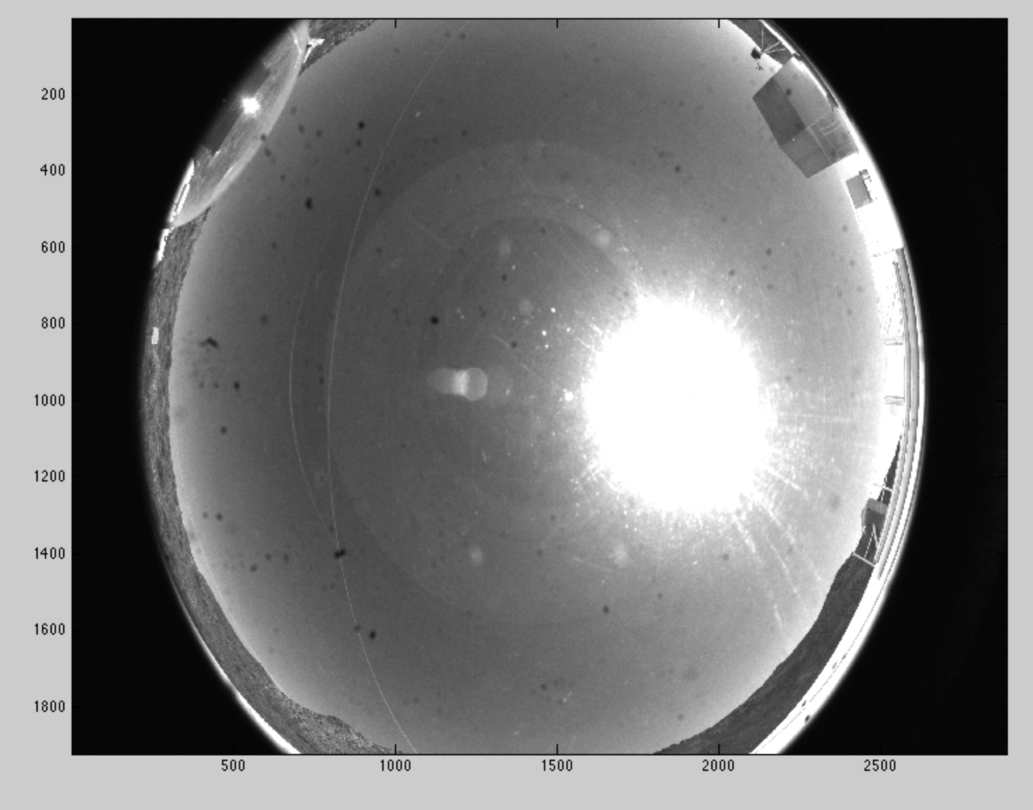
Detection of contrail lines with Hough transform

Slide 26
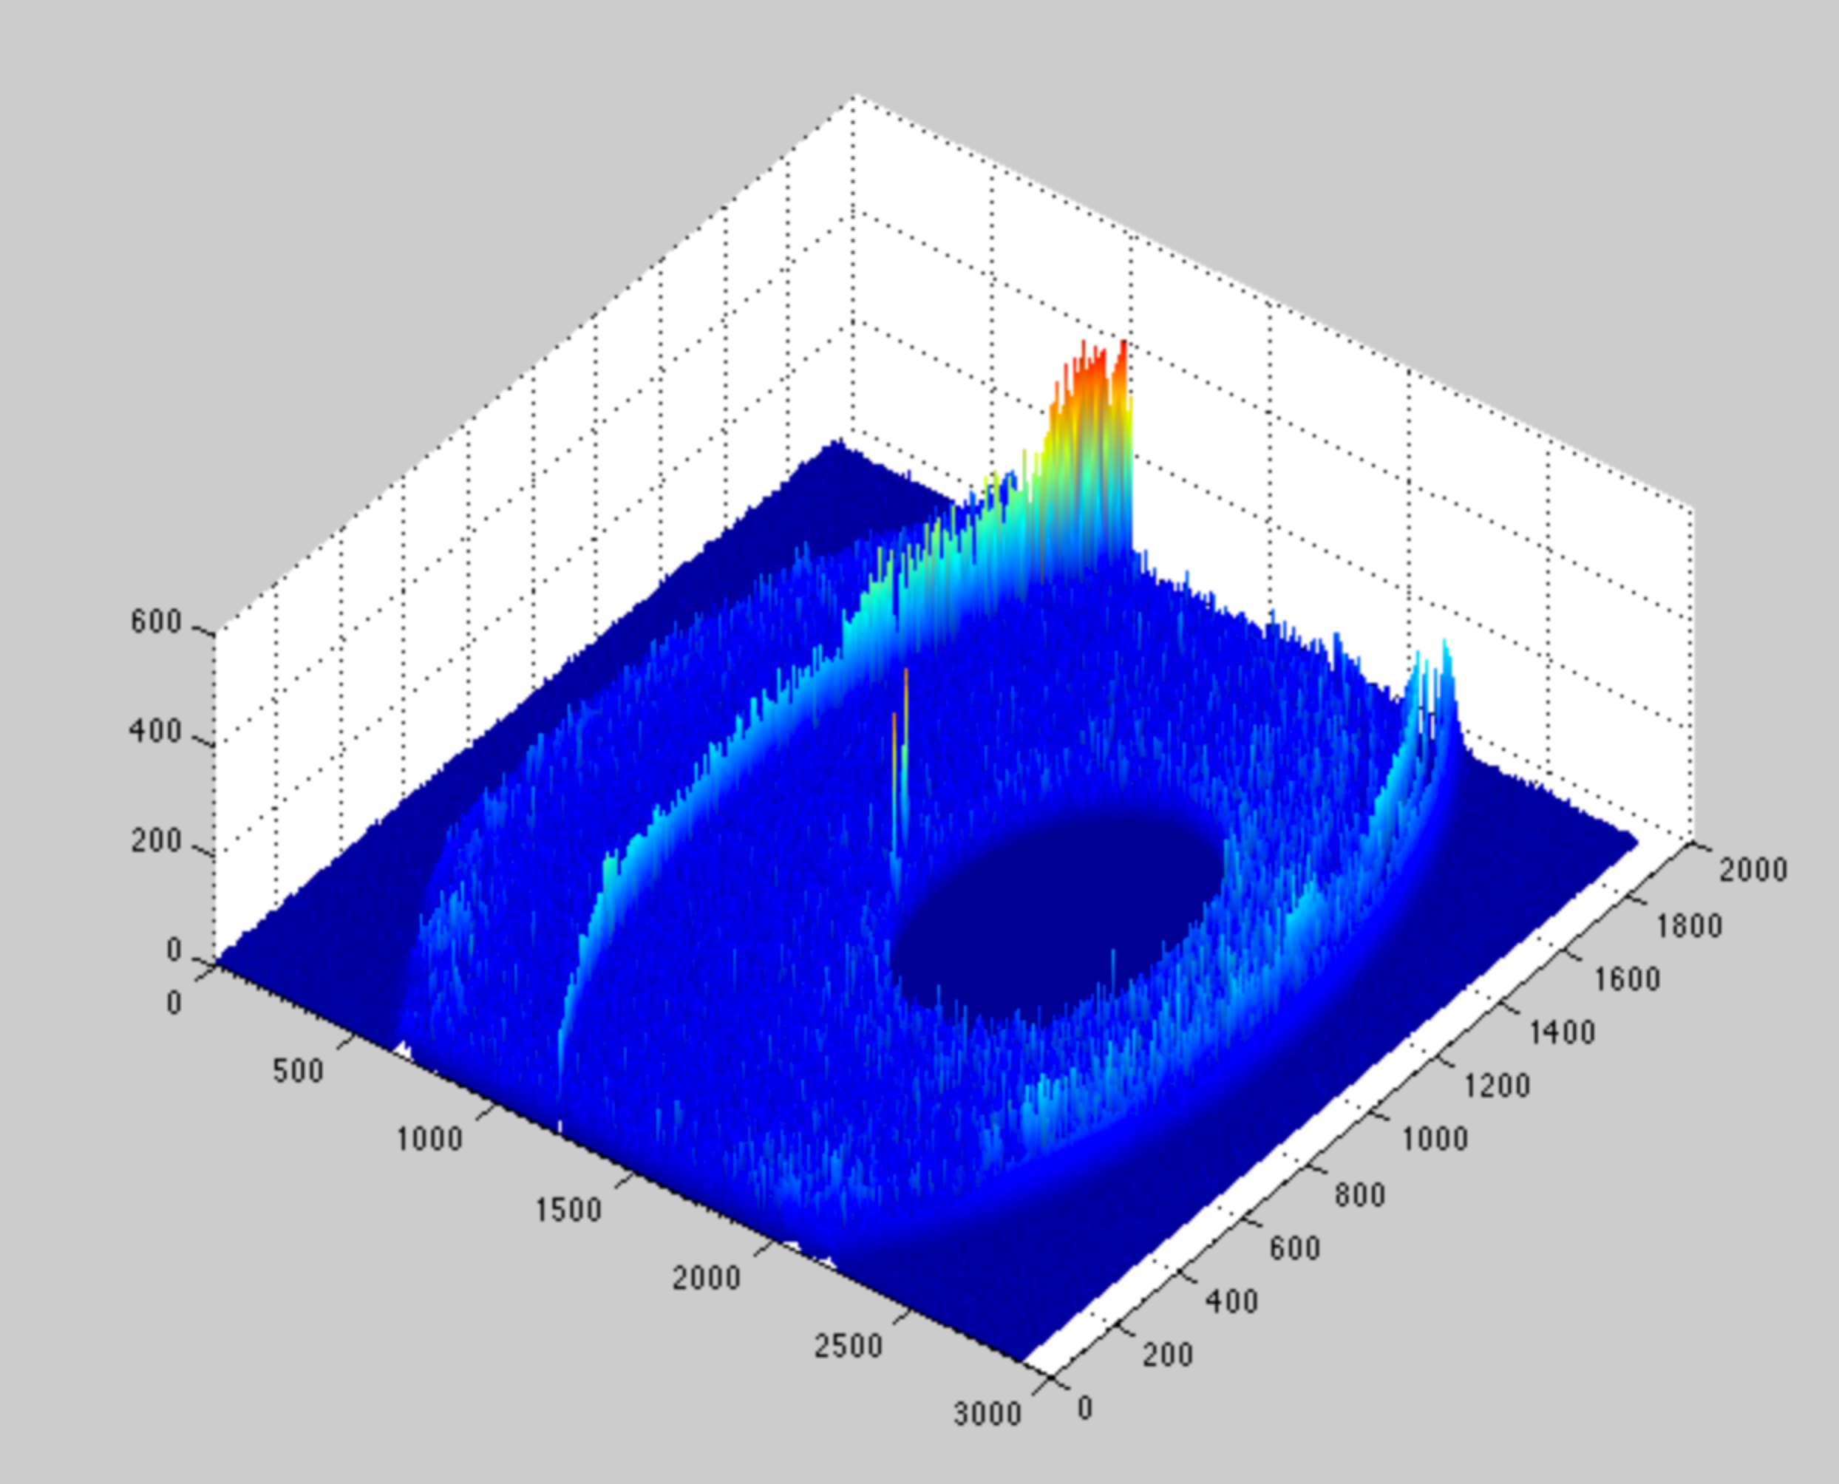
After sun suppression, image differencing, background subtraction, and spatial filtering

Slide 27
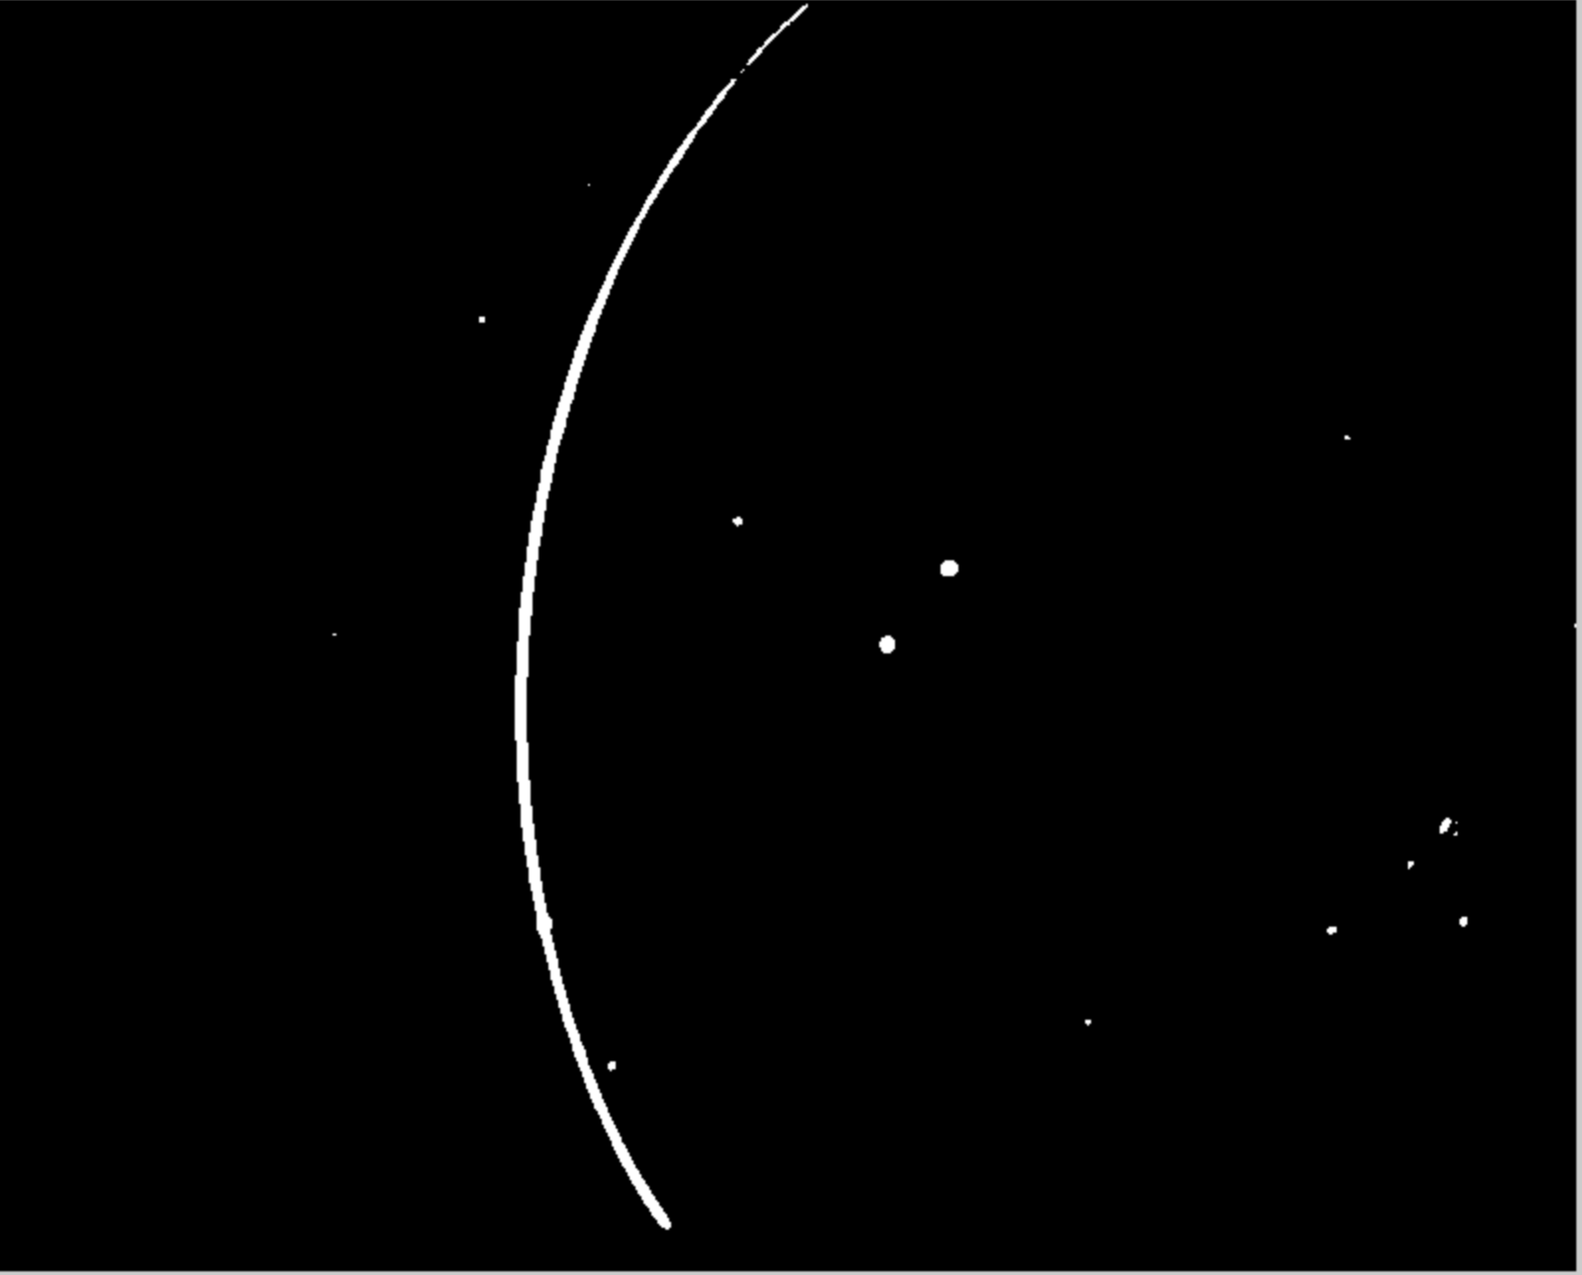
Mask frame in focal plane coordinates

Slide 28
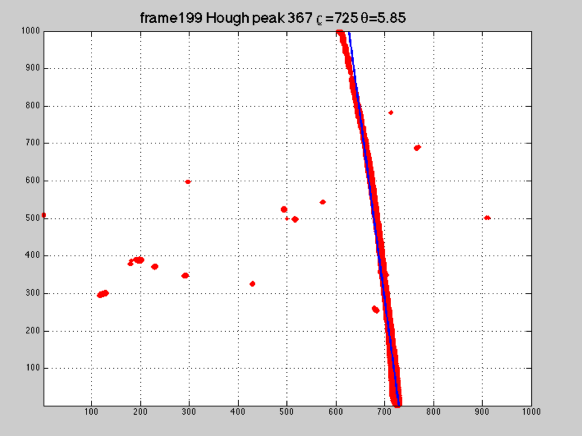
Above-threshold pixels in sky coordinates

Slide 29
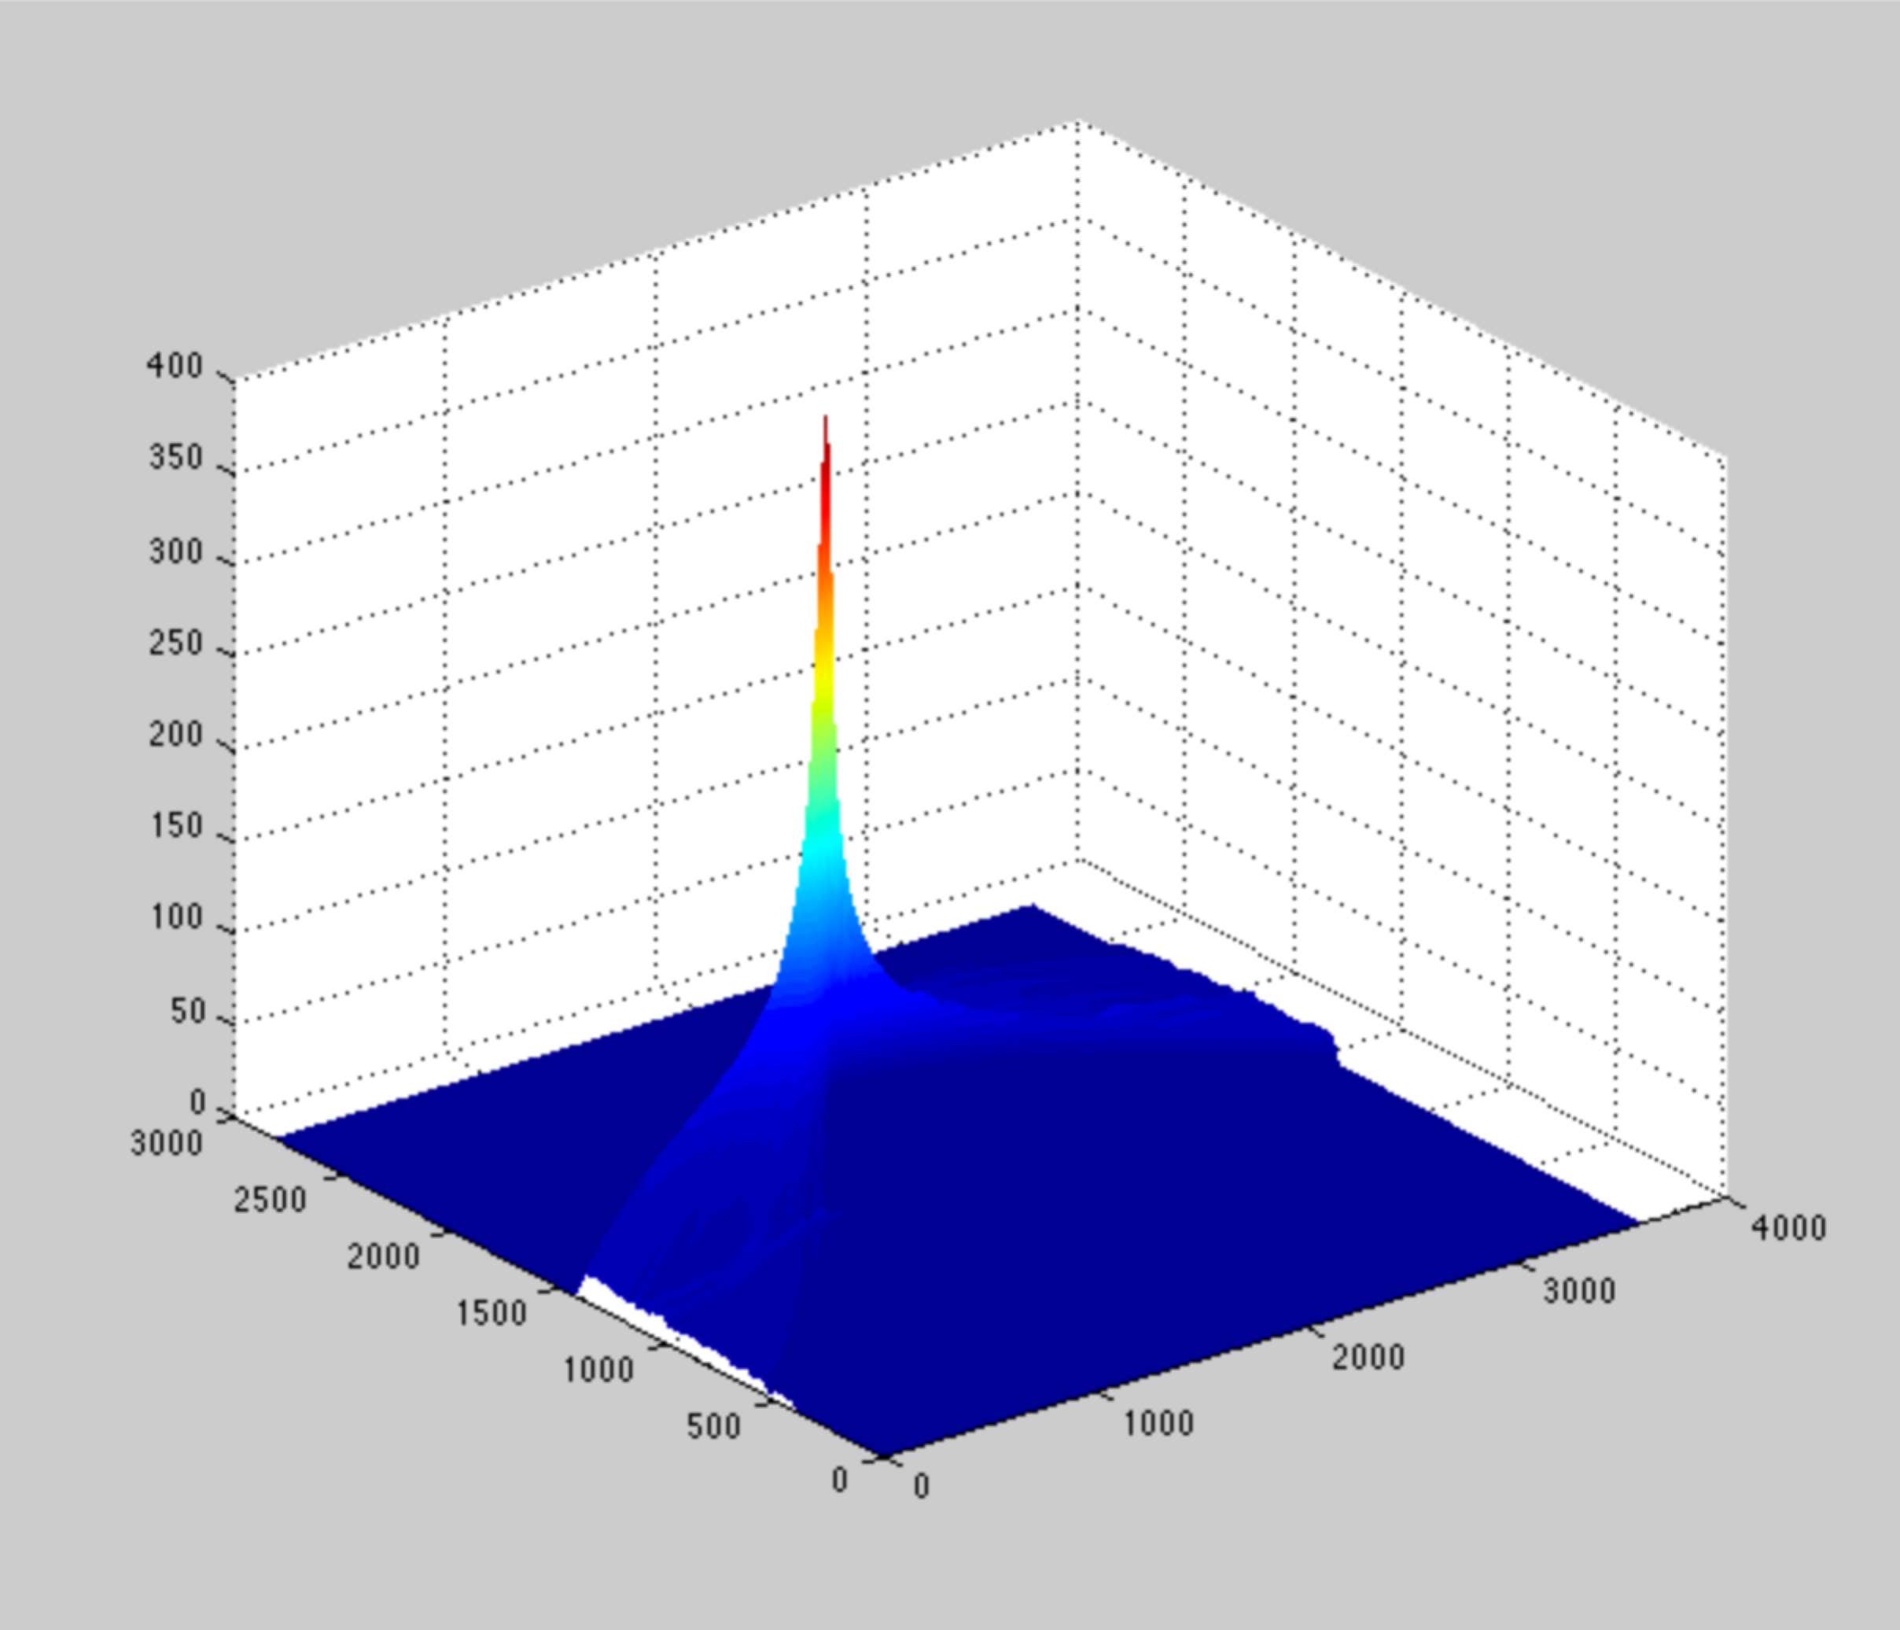
Hough transform is standard method for finding lines in images
Merit function
line distance from origin
line angle from y axis

Slide 30
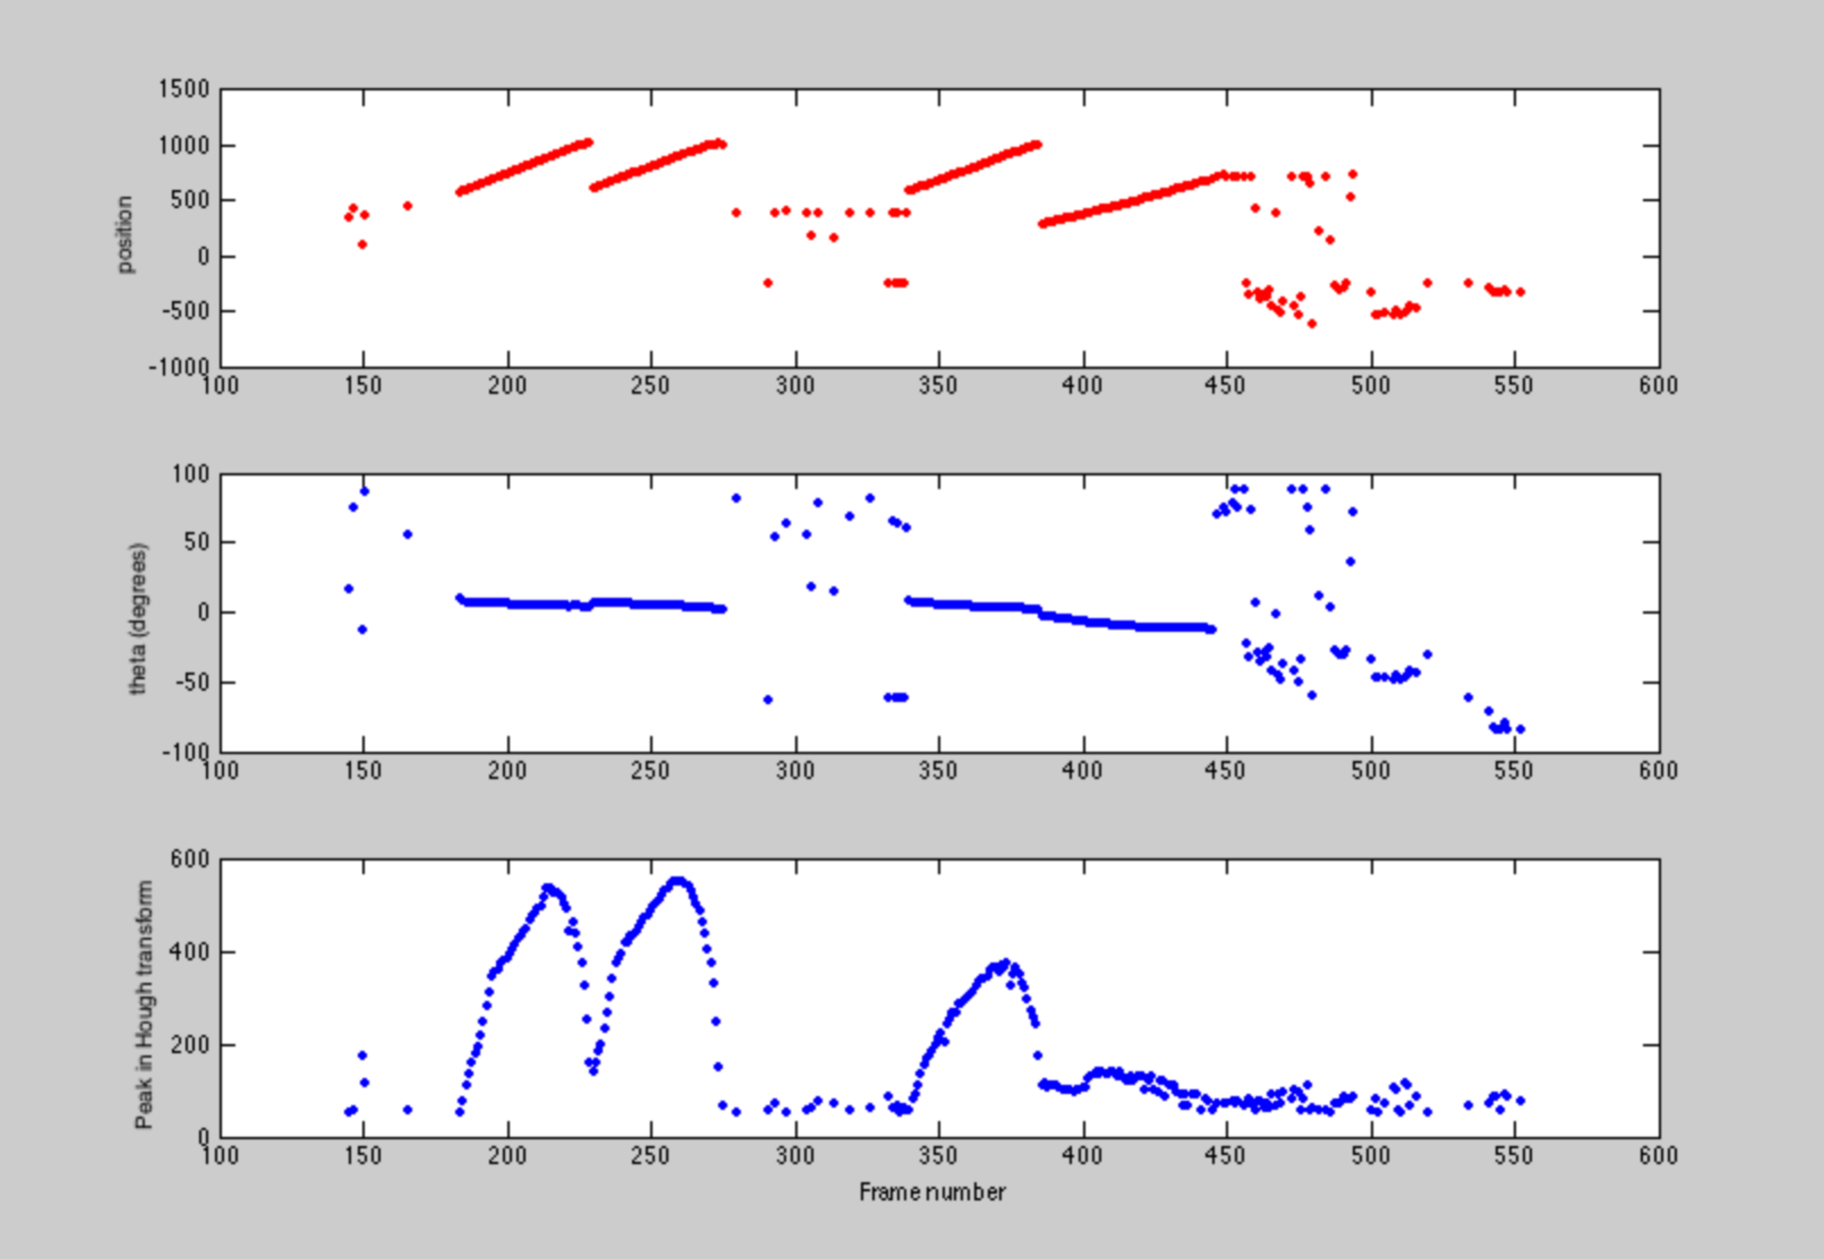
Evolution of line-fit parameters over 500 images
distance to origin
distinct contrails
θ
Hough filter peak

Slide 31
Next Steps
Run this analysis on a much more extensive data set
Correlate contrails with ADS-B detections of aircraft
Correlate daytime contrails with radiosonde data archive
Attempt similar sky-coordinate analysis with IR all-sky images
Make actual Kalman-filter predictions and compare to data
Revise code for faster/better execution
Translate to python
Devise interface specifications to scheduler
m5(alt,az,t)?

